Slide 1
CAPSTONE PROJECT-DATA SCIENCE DEVELOPMENT OF PREDICTIVE MODEL FOR FAILURE PREDICTIONS
BATCH 15 (IITD ACDSDS-03)
Anupam Deep Verma
Anurag Kumar

Slide 2
BACKGROUND OF PROJECT
This project pertains to predictive maintenance challenges encountered in the Metro train.
The project focuses on analysing data from an Air Production Unit (APU), installed on the roof of metro train, to predict when the system is approaching failure.
Readings from multiple sensors of APU is available for analysis.
This date set was taken from Kaggle.
The objective of case study is to develop a machine learning algorithm to predict failures using the historical data, to avoid operational problems.

Slide 3
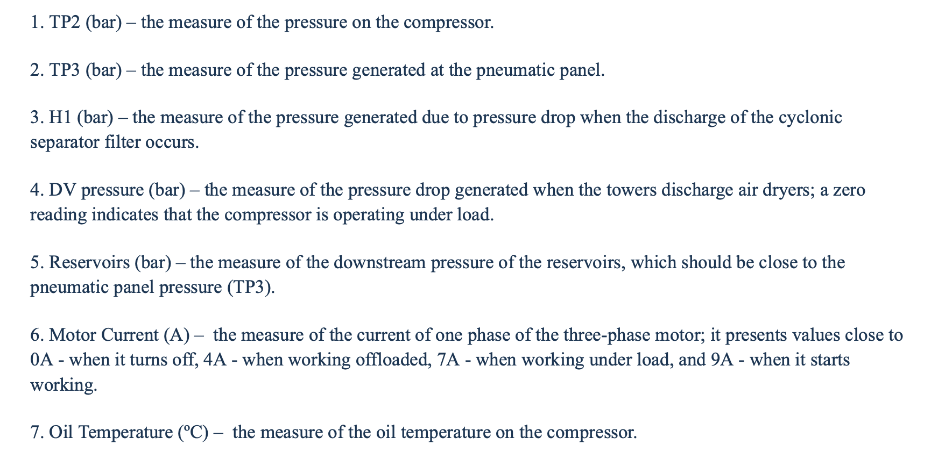
DATA SET DETAILS
The system installed in the vehicle’s APU collects data from Seven analog sensors and eight digital sensors.
The dataset consists of 15169480 data points collected at 10 Hz from February 20 to August 2020 and is described by 15 features from 7 analogue (1-7) and 8 digital (8-15) sensors:
ANALOG SENSORS

Slide 4
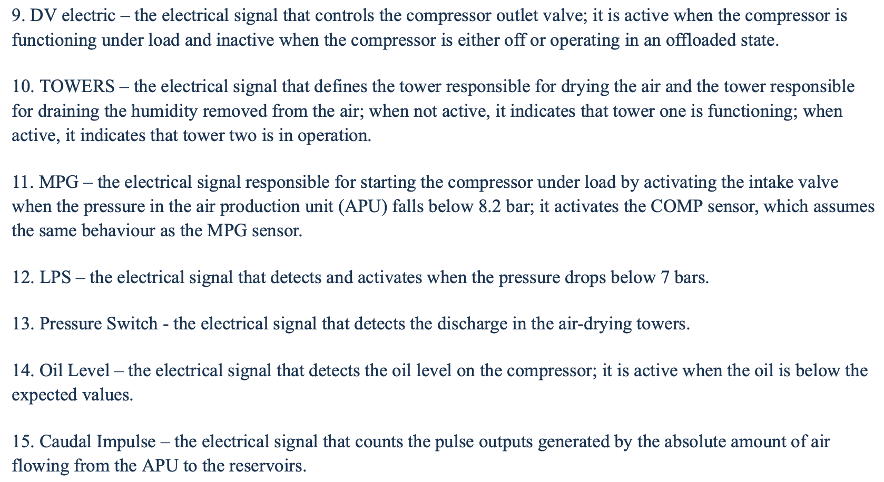
DIGITAL SENSORS

Slide 5
SAMPLE DATA
S. NO. | Data Recorded(10Hz) | date | time | TP2 | TP3 | H1 | DV Pressure | Reservoirs | Oil_temperature | Motor current | COMP | DV eletric | Towers | MPG | LPS | Pressure_switch | Oil_level | Caudal impulses
1 | 0 | 2020-02-01 | 00:00:00 | -0.012 | 9.358 | 9.340 | -0.024 | 9.358 | 53.600 | 0.0400 | 1.0 | 0.0 | 1.0 | 1.0 | 0.0 | 1.0 | 1.0 | 1.0
2 | 10 | 2020-02-01 | 00:00:10 | -0.014 | 9.348 | 9.332 | -0.022 | 9.348 | 53.675 | 0.0400 | 1.0 | 0.0 | 1.0 | 1.0 | 0.0 | 1.0 | 1.0 | 1.0
3 | 20 | 2020-02-01 | 00:00:19 | -0.012 | 9.338 | 9.322 | -0.022 | 9.338 | 53.600 | 0.0425 | 1.0 | 0.0 | 1.0 | 1.0 | 0.0 | 1.0 | 1.0 | 1.0
4 | 30 | 2020-02-01 | 00:00:29 | -0.012 | 9.328 | 9.312 | -0.022 | 9.328 | 53.425 | 0.0400 | 1.0 | 0.0 | 1.0 | 1.0 | 0.0 | 1.0 | 1.0 | 1.0
5 | 40 | 2020-02-01 | 00:00:39 | -0.012 | 9.318 | 9.302 | -0.022 | 9.318 | 53.475 | 0.0400 | 1.0 | 0.0 | 1.0 | 1.0 | 0.0 | 1.0 | 1.0 | 1.0
DATA POINTS
15169480
CONTINUOUS DATA
CATEGORICAL DATA

Slide 6
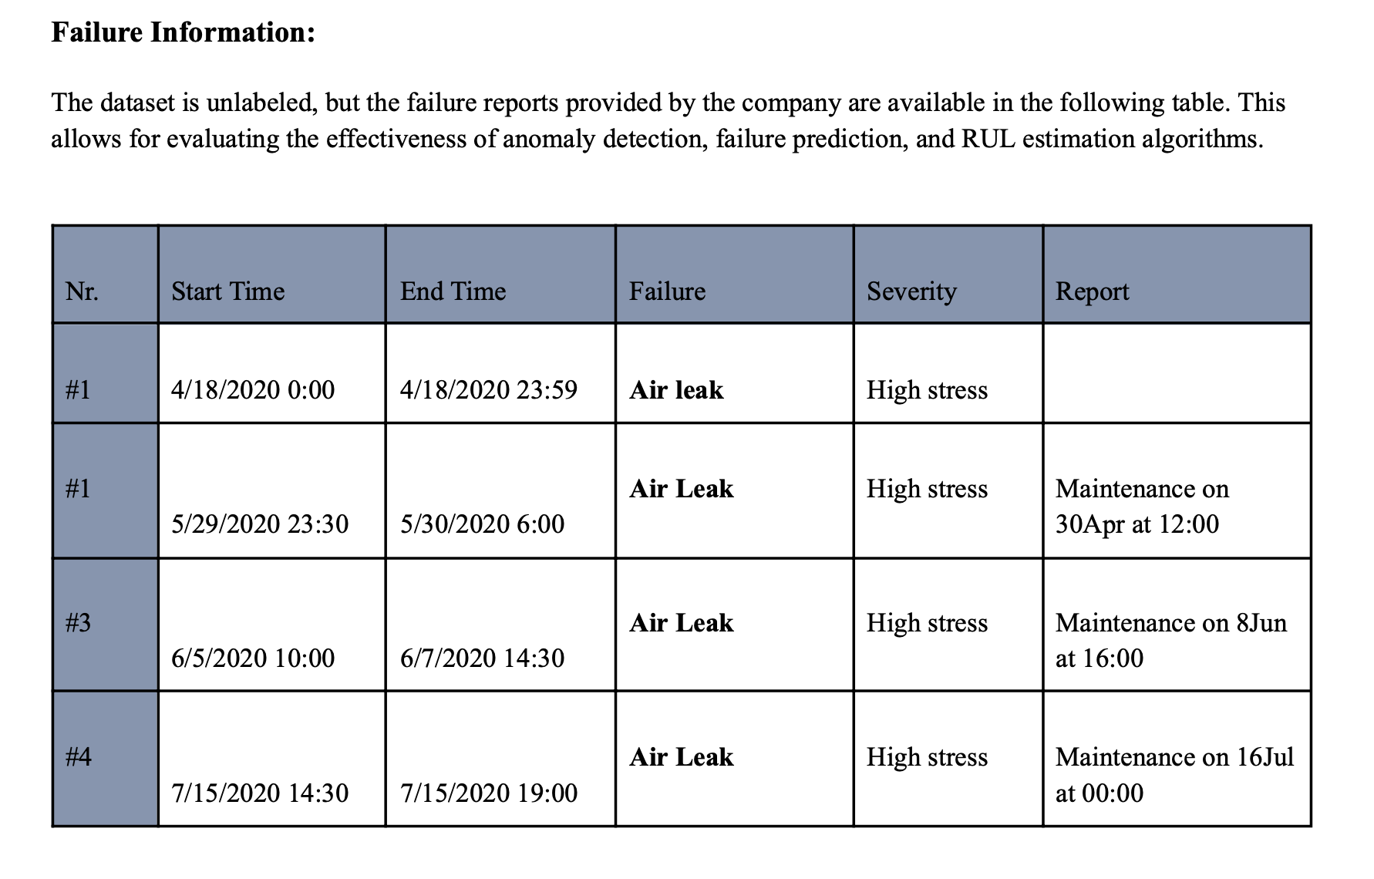
FAILURE INFORMATION

Slide 7
METHODOLOGY
Data Preprocessing
Cleaned data by removing missing values and unnecessary columns.
Data Analysis
Explore Pre-Failure Indicators
Feature Selection
Selected important features and dropped remaining features
Data Labeling
Labelled data by defining weekly, daily, and hourly pre-failure periods for detailed analysis.
Segmented data into normal operation and failure-specific periods to avoid data contamination.
Predictive Modeling
Compared different models like Logistic Regression, XG Boost, XG Boost Rolling Statistics, K-Means and Neural Network to classify healthy and impending failure states.

Slide 8
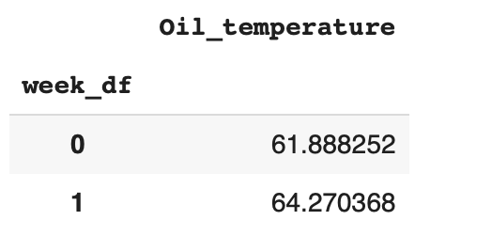
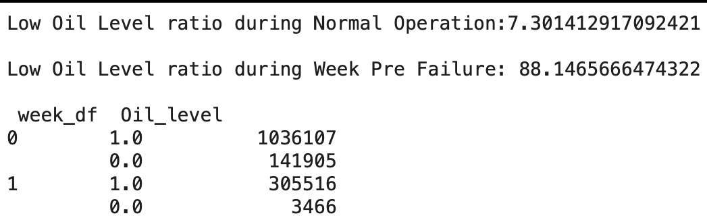
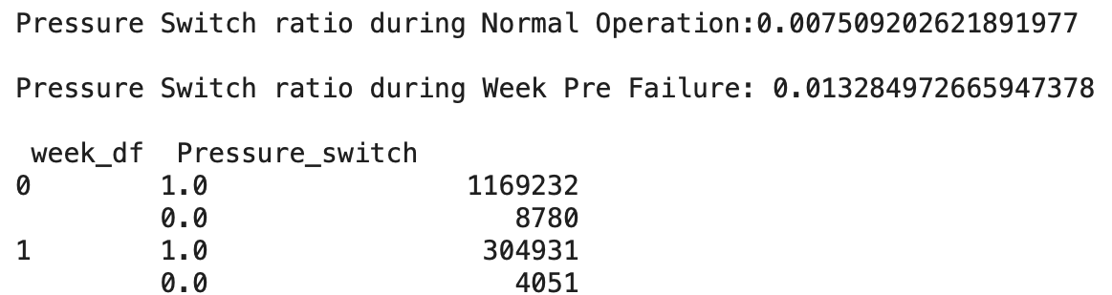
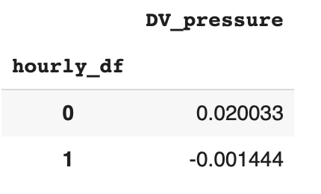
DATA ANALYSIS SOME PRE FAILURE INDICATORS
OIL TEMPERATURE
OIL LEVEL RATIO
DV PRESSURE
PRESSURE SWITCH

Slide 9
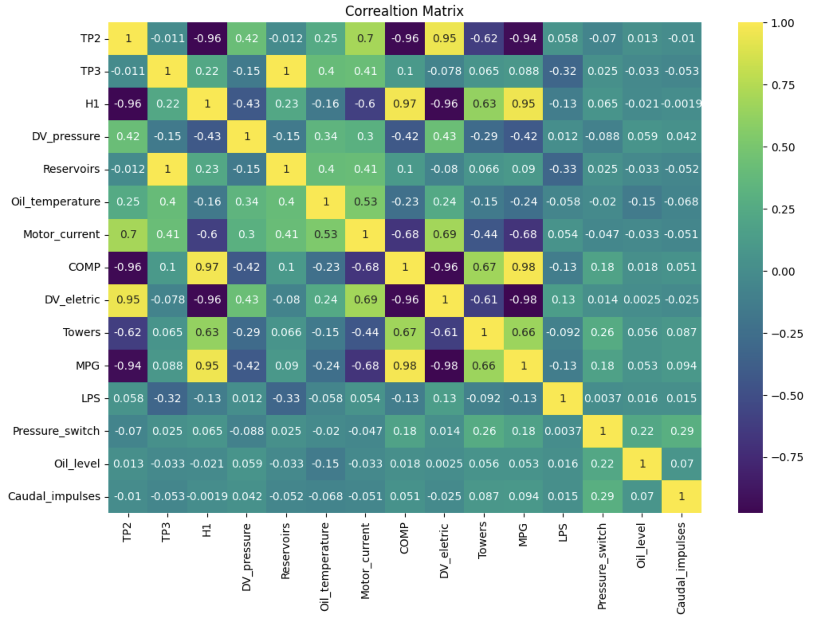
FEATURE SELECTION
CORRELATION ANALYSIS WAS DONE
H1, COMP, DV_ELECTRIC WERE DROPPED
H1 - THIS COLUMN IS HIGHLY CORRELATED WITH MULTIPLE FEATURES, AND AS EVALUATED PREVIOUSLY, IS NOT CORRELATED WITH ANY OF THE PRE FAILURE INDICATORS.
COMP - THIS SENSOR IS ACTIVE WHEN THE MPG SENSOR IS ACTIVE, WE WILL DROP THIS FEATURE AS THE MPG ACTIVATES BASED ON AN ACTUAL MEASUREMENT OF PRESSURE, WHICH THEN ACTIVATES THE COMP SENSOR.
DV_ELECTRIC - THE BEHAVIOR OF THIS FEATURE CAN BE QUANTIFIED BY THE MPG FEATURE THAT WE ARE KEEPING, SO WE WILL DROP THIS COLUMN.
REMAINING FEATURES WERE USED FOR FURTHER ANALYSIS

Slide 10
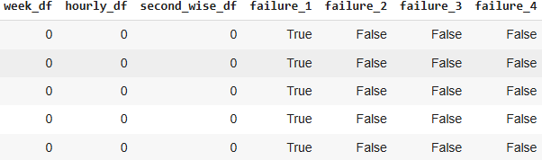
DATA LABELING
THREE COLUMNS WERE ADDED USING THE FAILURE INFORMATION GIVEN
ONE WEEK BEFORE FAILURE – DAY INTERVAL
ONE DAY BEFOR FAILURE – HOURS INTERVAL
ONE HOUR BEFOR FAILURE – 10 SEC INTERVAL
LABELING OF DATA FOR SPECIFIC TIME PERIODS WAS ALSO DONE
BEFOR FAILURE
BETWEEN FAILURE
Failure Information
Data Labeling

Slide 11
PREDICTIVE MODELING
LOGISTIC REGRESSION
X-G BOOST METHOD
IMPROVEMENT IN X-G BOOST USING ROLLING SATISTICS
K-MEANS
NEURAL NETWORK - MLP CLASSIFIER

Slide 12
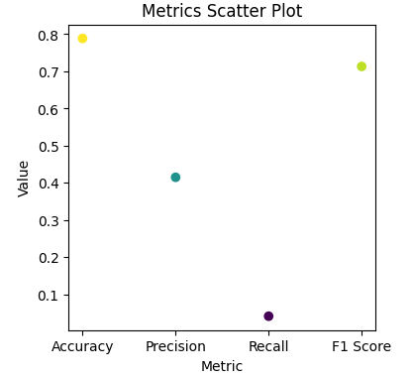

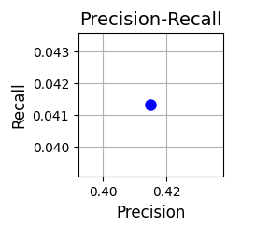
LOGISTIC REGRESSION
RESULTS

Slide 13
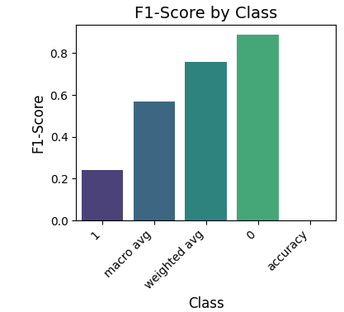
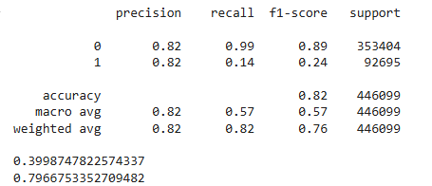
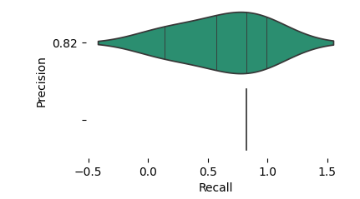
XGB CLASSIFIER MODEL FROM THE XGBOOST

Slide 14
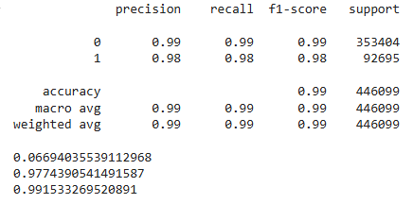
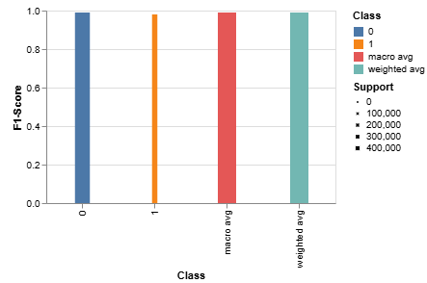
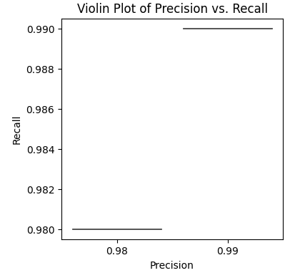
IMPROVEMENT IN X-G BOOST USING ROLLING SATISTICS

Slide 15
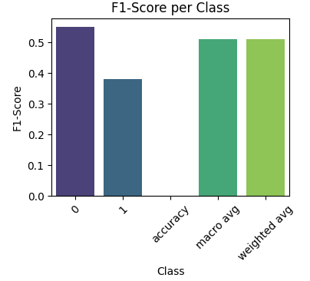
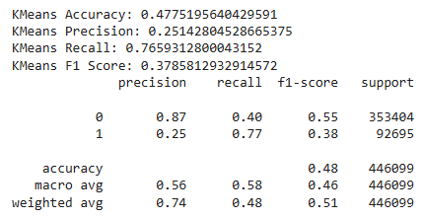
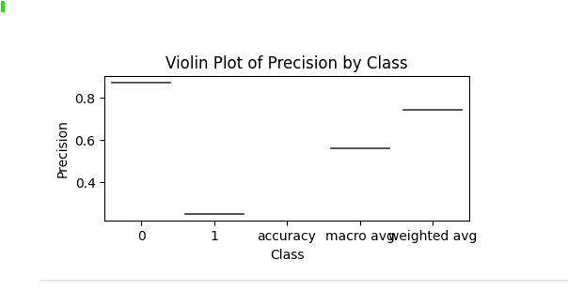
K-MEANS MODEL

Slide 16
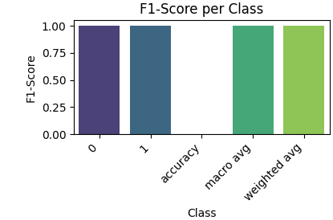
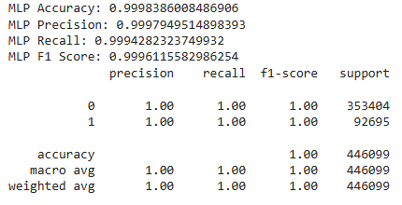
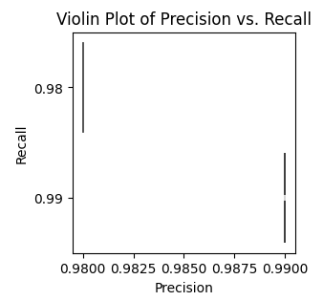
NEURAL NETWORK MLP CLASSIFIER

Slide 17
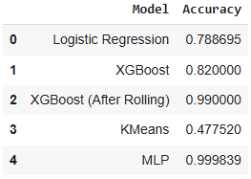
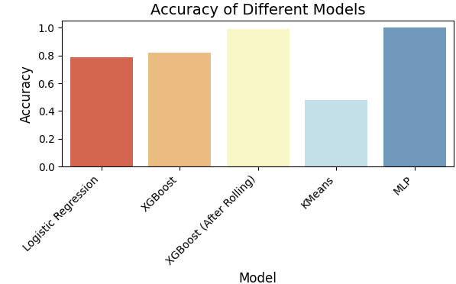
COMPARISON OF VARIOUS MODELS
 | ACCURACY | PRECISION | RECALL | F1 SCORE
LOGISTIC | 0.78 | 0.41 | 0.041 | 0.71
XG BOOST CLASS 0 CLASS 1 | 0.82 | 0.82 0.82 | 0.99 0.14 | 0.89 0.24
XGBOOST + ROLL OVER CLASS 0 CLASS 1 | 0.99 | 0.99 0.98 | 0.99 0.98 | 0.99 0.98
K-MEANS CLASS 0 CLASS 1 | 0.48 | 0.87 0.25 | 0.40 0.77 | 0.55 0.38
NEURAL NETWORK CLASS 0 CLASS 1 | 0.99 | 0.99 0.99 | 0.99 0.99 | 0.99 0.99

Slide 18
THANK YOU

